Slide 1

ASD – Data Driven Analytics

Slide 2

Project Leadership
Sharat Manikonda
Director at Innodatatics and Sponsor
linkedin.com/in/sharat-chandra

Slide 3
Team Members
Name : Vidhya Pounraj
Phone : WhatsApp - (91)9840643581/+31 633678341

Slide 4
Contents
Project Overview and Business Problem
Business objective and Constraints
CRISP-ML(Q) Methodology
Technical stacks
Project Architecture
Data collection and Understanding
Data Information
Data Dictionary
System Requirements
Exploratory Data Analysis
Observation of Missing values
Detection Of Outliers
Outliers Handling
Auto-EDA libraries
Data Visualizations Using Power BI
Data visualizations using google looker studio
Data visualizations using Excel
Challenges
Future Scopes
Queries
Notes:
Change

Slide 5
Project Overview
Autism Spectrum Disorder (ASD) is a neurodevelopmental condition characterized by challenges in social interaction, communication, and repetitive behaviours. The project aims to address the challenge of deriving meaningful insights and creating interactive dashboards from the data extracted.
Business Problem
While videos are captured, what kind of insights and dashboards can be generated using the data extracted from video analytics is still unclear.

Slide 6
Business Objective
Business Objective
Maximize the effective utilization of data.
Business Constraint
Minimize usage of manual creation of reports.
Success Criteria:
Business Success Criteria
Actionable insights should increase to at least 90%
Economic Success Criteria
By providing timely intervention, the adverse effects of a specific behavior exhibited can be avoided.
Notes:
Change

Slide 7
CRISP-ML(Q) Methodology
There are six stages of CRISP-ML(Q) Methodology
Business and data understanding
Data preparation
Model building
Model evaluation
Model deployment
Monitoring and maintenance

Slide 8
Technical Stacks
Programming Languages:
Python - Python is the popular programming language in Data Science due to its extensive libraries and community support.
Database: MySQL - for querying and extracting data from relational database.
Data cleaning and preprocessing: Pandas: for data manipulation
Data visualization Tools: Power BI, Google looker studio, MS Excel
Data storage and preprocessing:Database(MySQL)- for strong structured and unstructured data.
Notebooks and IDEs:Spyder for data exploration and analysis.
Collaboration and communication: Google Meet

Slide 9
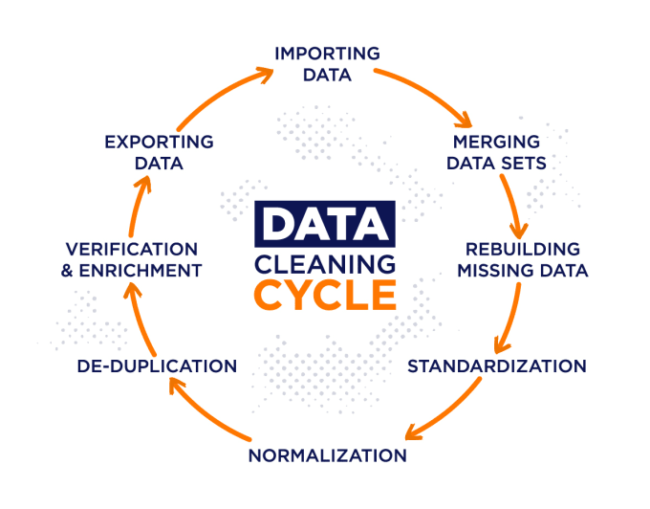

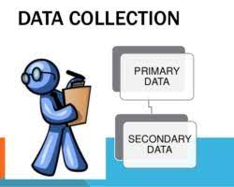




Project Architecture
Data Collection Methods
Data Storing
Data Preprocessing
Pre-processed data storage
Users
Load data into this visualization tools

Slide 10
Data Collection and Understanding
Overview of Data Set:
dataset 1 - data.CSV dataset 2 - data.CSV
Total Rows: 28,189 Total Rows: 41
Total Columns: 8 Total columns:3
2.Data Source : Collected the relevant data from the identified sources
3. Data Columns:
data.csv - uid,asd_project34_video_id,user_name,duration,class_name,probability,fps,date_time
video_details.csv - video_id name length

Slide 11
Data Information
Data Source : It is a secondary data source collected from excel spread sheet.
Data size: data.csv contains 28189 rows × 8 columns
video_details.csv contains 41 rows x 3 columns
Data preprocessing: Finding and removing outliers
EDA: Gained insights and identified patterns, outliers, and relationships within the data.
Visualization: Power bi, Excel, Google looker studio
Data Preprocessing
File Name | Missing values | Duplicates | Outliers
data.CSV | No null values | No Duplicates | 6555
video_details.CSV | No null values | No Duplicates | No outliers

Slide 12
Data Dictionary
data.xlsx
Column name | Description
uid | Unique Id
asd_project34_video_id | video_id from video_details.xlsx
user_name | name of the autistic kid
duration | exact time stamp of that frame in seconds
class_name | the behavior that a child is exhibiting
probability | probability of that particular class that a person is exhibiting
fps | frame per second as per the asd_project34_video_id
data_time | data and time stamp when that particular frame is analyzing
video_details.xlsx
Column name | Description
video_id | unique id for a particular video
name | name of the video
length | entire duration for a particular video

Slide 13
System Requirements
Hardware:
Processor: Intel(R) Xeon(R) Gold 6136 CPU @ 3.00GHz 3.00 GHz
RAM:12.0 GB
Storage: 512 GB
Operating System :
OS Name Windows 10 Enterprise
Version: 22H2, OS Build 19045.3930
Software and Development Environment:
Python and packages like Pandas, NumPy, Matplotlib etc..
IDE : Spyder, Jupyter Notebook
Database :
MySQL workbench
Ineternet
high speed internet connection
Security and privacy : Yes
Regular backups and data management to prevent data loss
Visualization : Power BI, Google looker studio, excel
Communication and Collaboration : Google meet

Slide 14
Exploratory Data Analysis [EDA]
File Name | Column Name | First Business Moments |  |  | Second Business Moments |  |  | Third Business Moments | Fourth Business Moments
 |  | Mean | Median | Mode | Variance | Standard Deviation | Range MAX-MIN | Skewness | Kurtosis
clean_data.CSV | duration | 41,57861645 | 32,43 | 2,8 | 1114,863094 | 33,38956565 | 129,01 | 0,722670323 | -0,640306519
 | probability | 0,980262495 | 0,998815765 | 1 | 0,001222375 | 0,034962485 | 0,1472145 | -1,990652327 | 2,973169953
 | fps | 23,23246643 | 29,769 | 12,4961 | 65,14944316 | 8,071520498 | 17,5483 | -0,506367201 | -1,639769619
Video_details.CSV | length | 24,3902439 | 14 | 11 | 422,5939024 | 20,55708886 | 55 | 0,912648144 | -1,004740478
Notes:
EDA is used for seeing what the data can tell us before the modeling task.
Change

Slide 15
Data Pre-processing
Data collection:
Collected raw data from excel spread sheet.
Data inspection:
It consists of dataset1 - 28189 rows X 8 columns and dataset 2 – 41 rows X 3 columns
Has no missing values and no null values
Data cleaning:
Removed duplicated values
Identified outliers and removed outliers
Corrected inconsistency data
Visualization:
Created visualizations for exploring the data and identifying the patterns
Data validation:
Monitoring and validating the quality of data to remain accurate.
Notes:
Keep observations

Slide 16
Observation of Missing values
1.
Find missing values in the DataFrame
missing_values = clean_data.isnull()
Count the number of missing values in each column
missing_counts = missing_values.sum()
Display the missing values counts
print("Missing values counts per column:")
print(missing_counts)

Slide 17
Detection of Outliers
1.
Using IQR Method – Detected the outliers
Outliers Handling
Using IQR Method – Removed the outliers
Created a new DataFrame without outliers

Slide 18
Auto-EDA Libraries
1
Created visualizations and dashboards using the below Auto-EDA libraries.
sweetviz
autoviz
pandas-profiling
Dtale
Dataprep

Slide 19
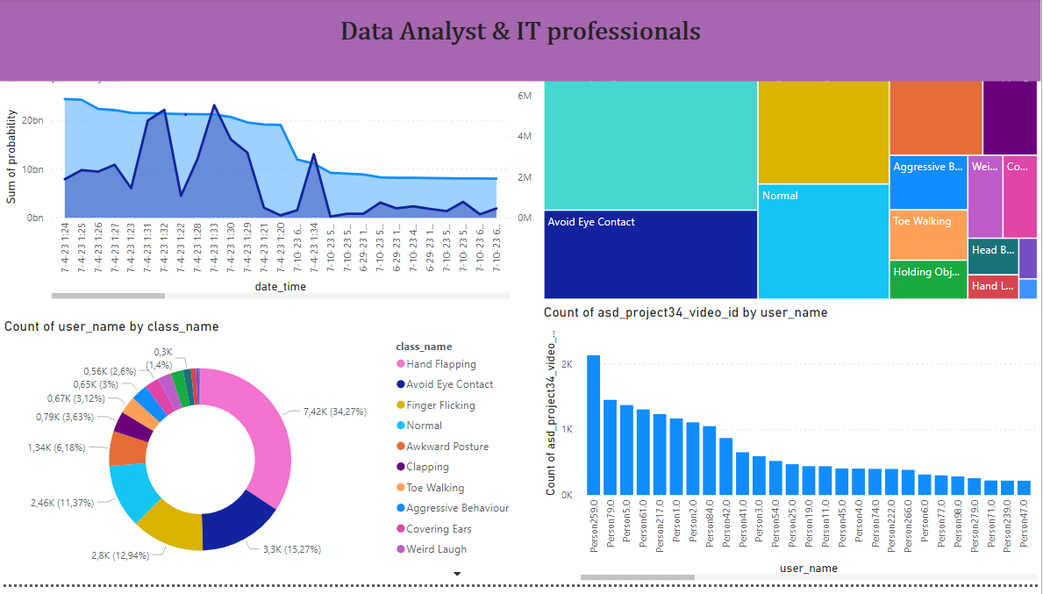
Data Visualization in Power Bi
Notes:
Add graphical

Slide 20
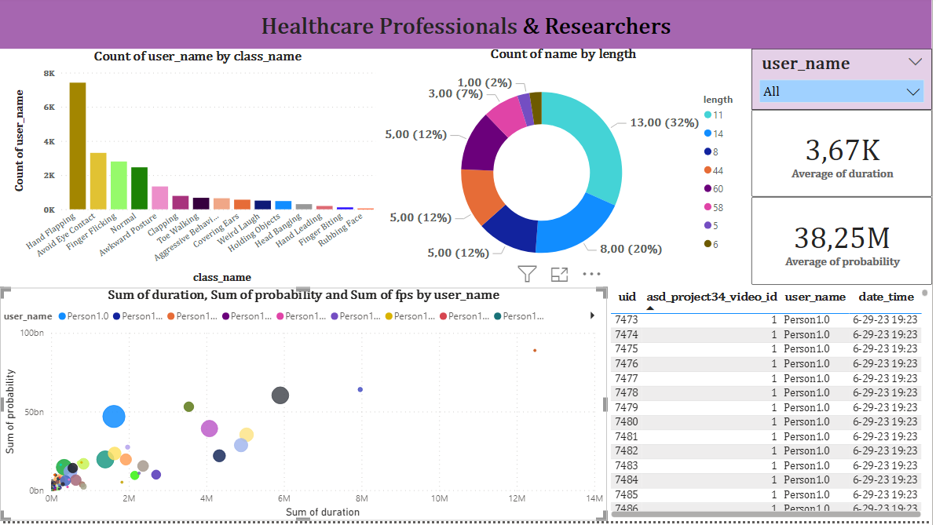
Data Visualization in Power Bi
Notes:
Add graphical

Slide 21
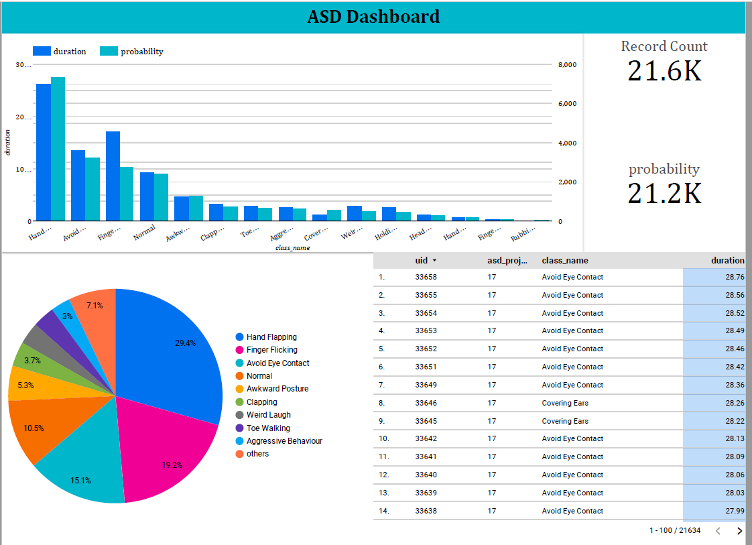
Data Visualization in Google Looker
Notes:
Add graphical

Slide 22

Data Visualization in Excel
Notes:
Add graphical

Slide 23
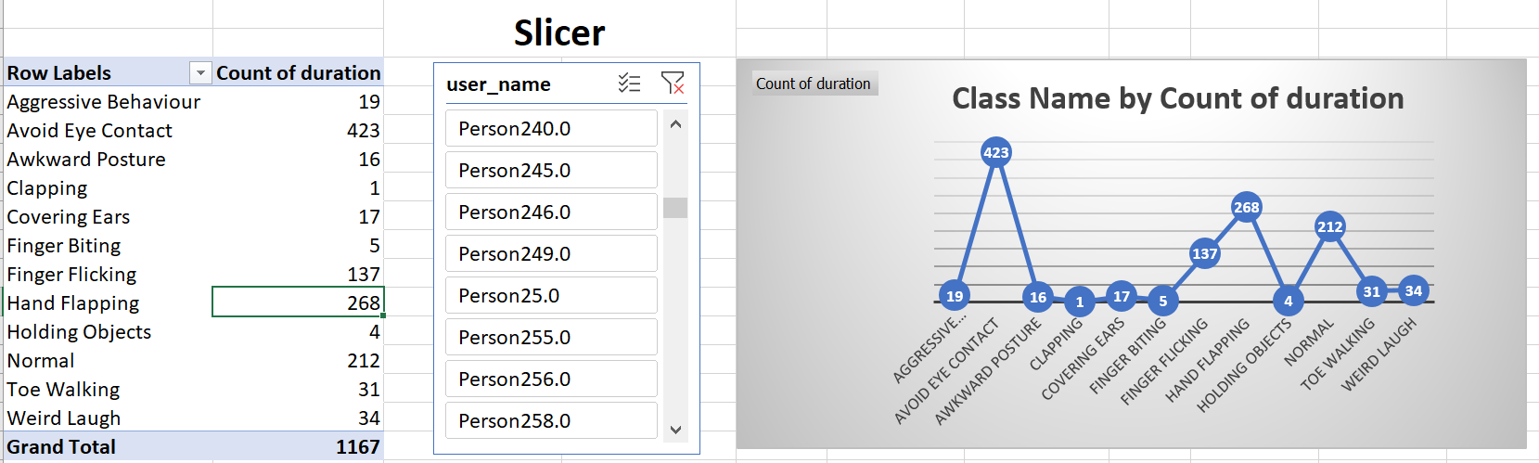
Data Visualization in Excel
Notes:
Add graphical

Slide 24
Challenges
I encountered challenges in effectively updating outliers and determining the lower and upper bounds within the interquartile range (IQR).
Additionally, while I successfully replaced outliers with median values and saved the cleaned dataset, I faced a subsequent challenge when importing the cleaned data into python.

Slide 25
Queries ?
Q&A

Slide 26
THANK YOU

